Slide 1
EDA with King County House prices
finding a house to buy for Thomas Hansen

Slide 2

Goal of this notebook
Find top houses to buy for Thomas Hansen
Dataset: King County house prices
Stakeholder Information:
- 5 kids
- no money
- wants nice (social) neighbourhood
- Timing?
- Location?

Slide 3
Content
Exploratory data analysis (EDA)
Get an overview of the data
Filter data and create new values regarding Thomas Hansens needs
Create a scoring system
Show results in order of highest to lowest score

Slide 4
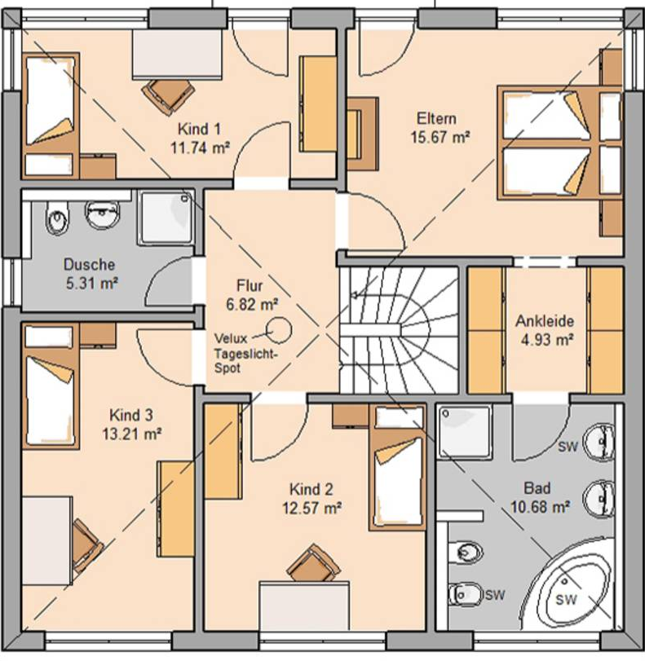
No money + 5 kids
Filtering existing data
- Price - cheapest 25%: <= 322k US$
- Bedrooms - biggest 25%: >= 4 bedrooms
- Bathrooms - biggest 25%: >= 2.5 bathrooms
- Sqft_living - biggest 25%: >= 2550 sqr feet
→ Only 66 of 21,597 houses left

Slide 5
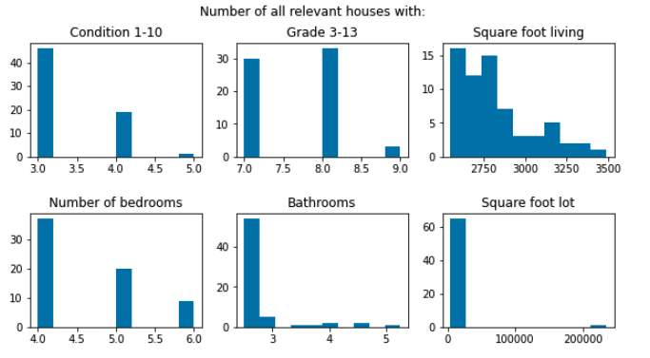
House comparison

Slide 6
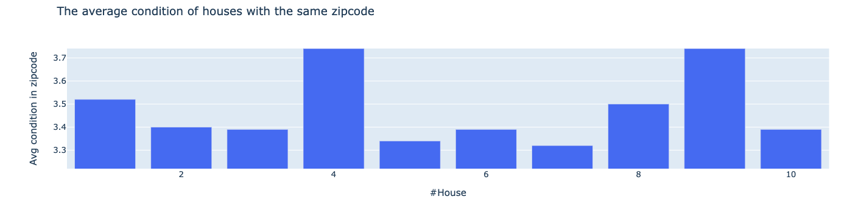
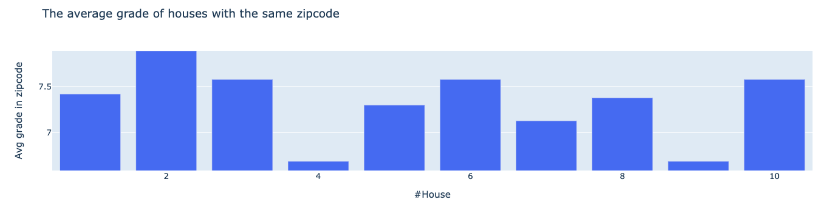
Nice (social) neighbourhood
Defining new values: average condition and average grade in the neighbourhood
average condition
and
average grade within the same zipcode

Slide 7
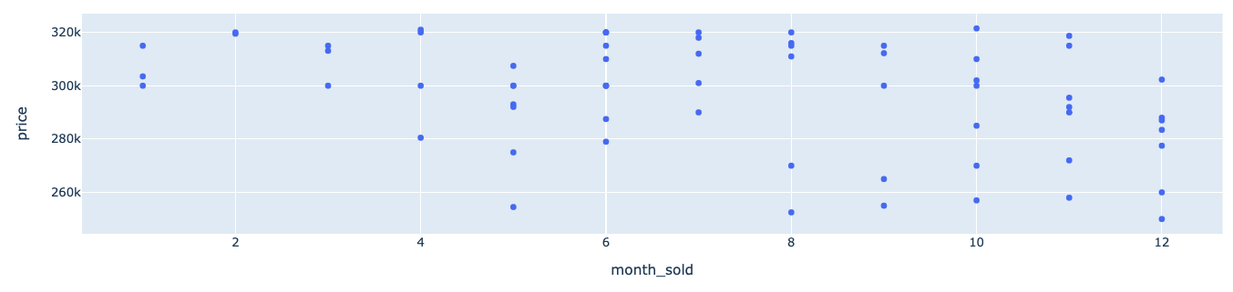
Timing?
Checking, when cheapest houses were sold
Stakeholder background:
Timing?
Thomas Hansen seems unsure about the timing to buy a house. Regarding our 66 houses, we show, when the cheapest houses were sold. It appears, May and August-December could be good timing.

Slide 8
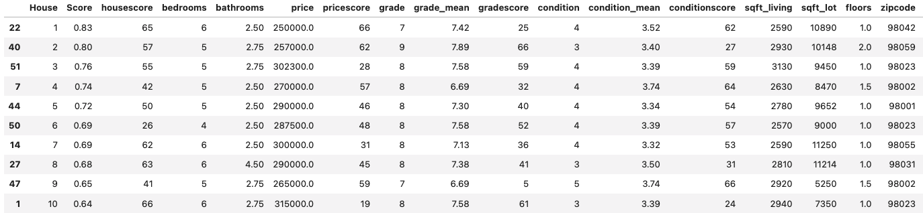
Building an individual scoring system
housescore: best overall values (in this priority order: bedrooms, bathrooms, price, condition, grade)
pricescore: cheapest price
conditionscore: highest condition of this house and the neighbourhood houses
gradescore: highest grade of this house and the neighbourhood houses
Final Score: We divide by the qty of rows (here: 66) and the qty of different scores (here: 4). This results in a score between 0 and 1 (with 1 being the perfect score).

Slide 9
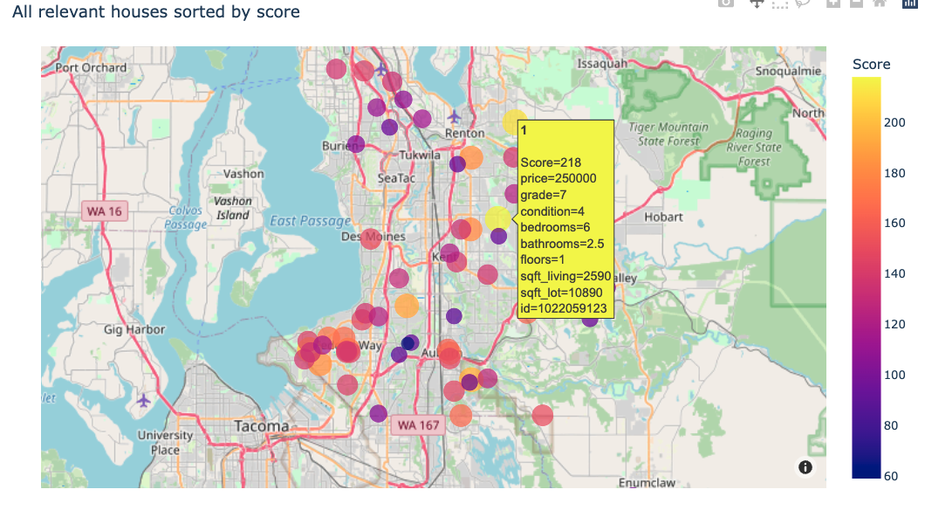
Result: Relevant houses in streetmap

Slide 10
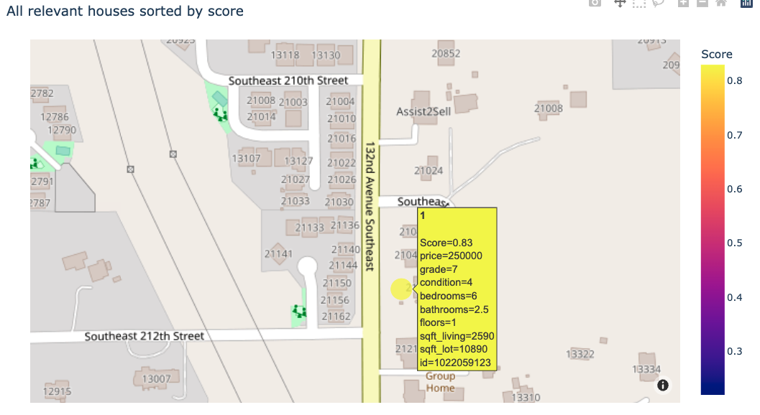
Zooming in on #1
Playgrounds for the kids - yaay!

Slide 11
Summary, Bonus and Outlook
Summary
analysis and filters according to Thomas Hansen’s needs
creation of a scoring system
plotting the results on a map, incl. relevant hover data
Recommendation: use the map (sorted by score) and have a look at the area of the house
Outlook
the scoring system could be used for other stakeholders. A Python script could be created, which asks for input (e.g. # of bedrooms, price limit, ...) and automatically plots output
additional values could be included within the scoring system, such as: sqft_living, sqft_lot, floors
Bonus: Deep dive
histograms for relevant data of all filtered and top 10 houses
bar charts for most important information for each of the top 10 houses
neighbourhood bar charts (average grade and condition)

Slide 12
Deep dive: Optional

Slide 13
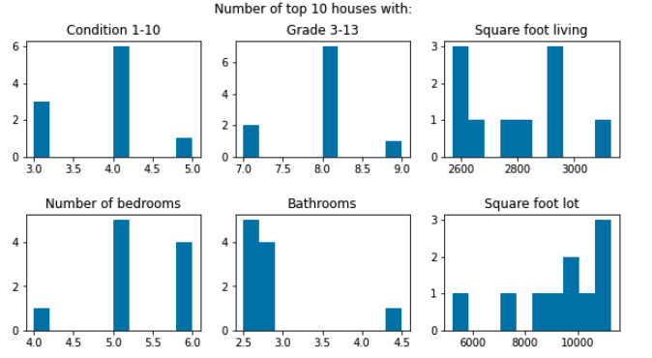
House comparison
We can compare our Top66 with our Top10.
Top 10 include more relative houses with higher condition, more bedrooms.

Slide 14
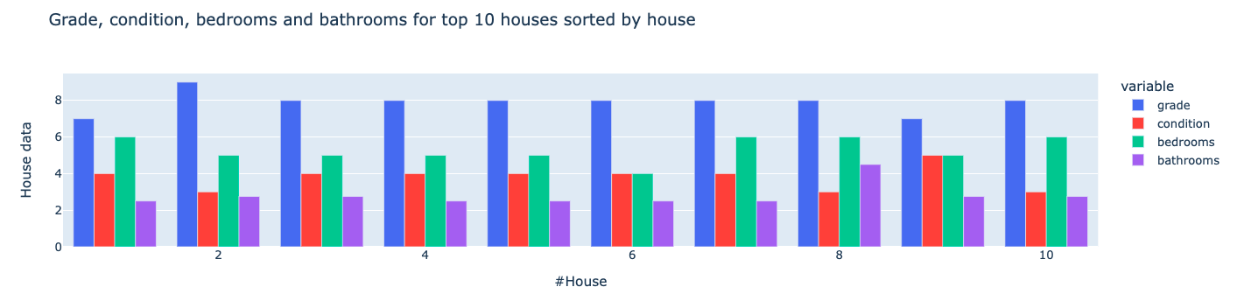
Comparison between top10 houses
Interestingly our #1 has the lowest grade within the top10.
This shows, our individual scoring is different compared to KingHouse grading.
(But it has 6 bedrooms, one for each kid + one for the parents. Sounds great!)

Slide 15
Comparing the neighbourhoods

Slide 16
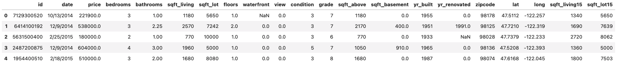
The data explained
id - unique identified for a house
dateDate - house was sold
pricePrice - is prediction target
bedroomsNumber - # of bedrooms
bathroomsNumber - # of bathrooms
sqft_livingsquare - footage of the home
sqft_lotsquare - footage of the lot
floorsTotal - floors (levels) in house
waterfront - House which has a view to a waterfront
view - Has been viewed
condition - How good the condition is ( Overall )
grade - overall grade given to the housing unit, based on King County grading system
sqft_above - square footage of house apart from basement
sqft_basement - square footage of the basement
yr_built - Built Year
yr_renovated - Year when house was renovated
zipcode - zip
lat - Latitude coordinate
long - Longitude coordinate
sqft_living15 - The square footage of interior housing living space for the nearest 15 neighbors
sqft_lot15 - The square footage of the land lots of the nearest 15 neighbors

